Slide 1
Cyanovirus update Sandusky Bay update
Bullerjahn Lab, BGSU
Katelyn McKindles
Michelle Neudeck

Slide 2





Acknowledgements
Tim Davis, BGSU
Silvia Newell, Wright State
Nathaniel Ostrom and Kateri Salk, Michigan State
Lauren Kinsman-Costello, Kent State
Laura Johnson, Heidelberg and NCWQR
ODNR, OSU and USGS crews

Slide 3
Viral update
Viruses (phages) that attack cyanobacteria and kill the bloom biomass

Slide 4
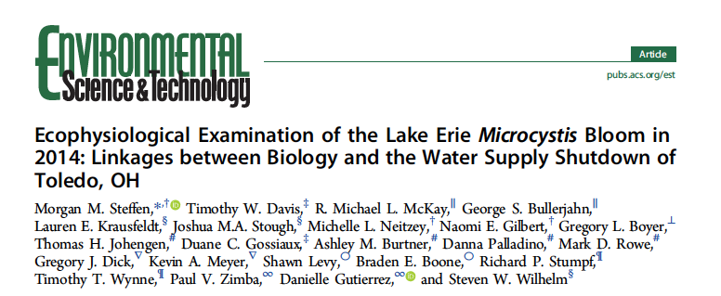
Genomics of the 2014 Toledo Bloom
Study examined the microbial community present in the Toledo event, and all the genes active in the community
Steffen et al. 2017. Environ. Sci. Technol. 51: 6745-6755

Slide 5
Study approach
Sampled western Lake Erie the last day of the water shutdown
High toxicity of the bloom was a surprise…why?
Isolated DNA and RNA from bloom biomass
Sequenced it all, did all the bioinformatics
RNAs from viruses that kill Microcystis were among the most abundant

Slide 6
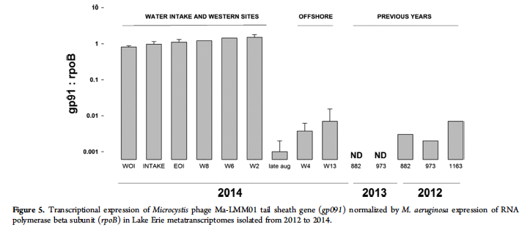
Results
Gene for the major tail sheath protein of the Microcystis virus is highly expressed at the time of the Toledo water crisis

Slide 7
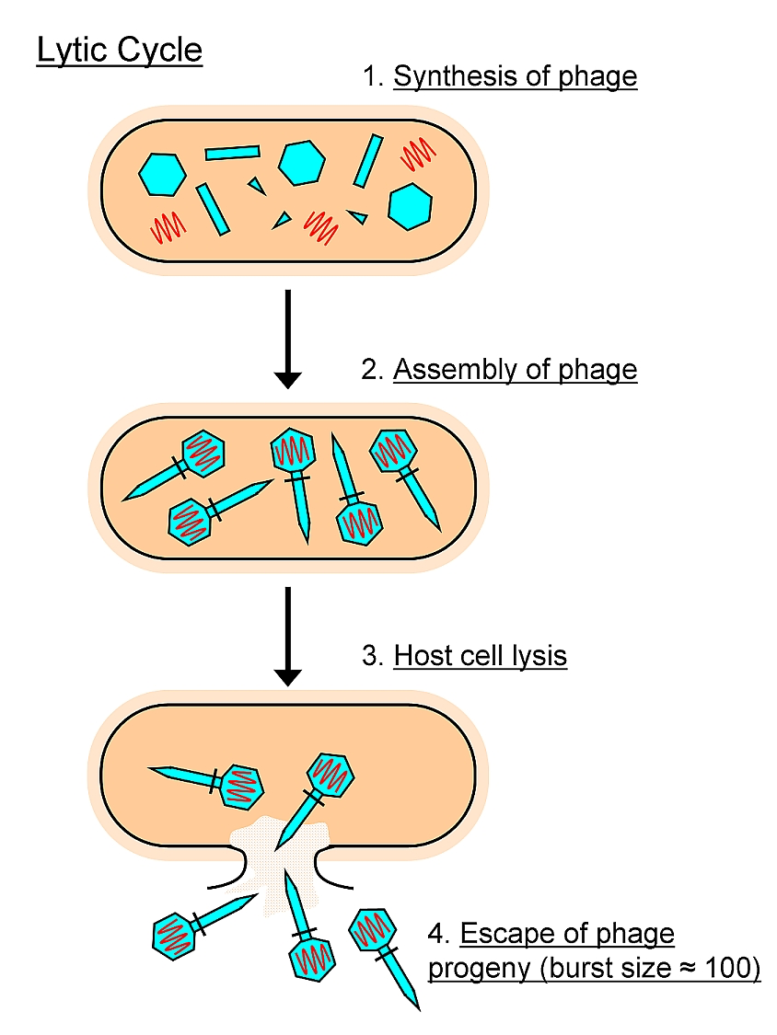
Release of toxin by viral lysis
Toxin retained inside
cells
MC
Dissolved toxin requires additional chemical treatment of water
We are developing a PCR-based method for WTPs to detect viruses in raw water
MC
Toxin released as cells rupture – harder to eliminate
MC

Slide 8
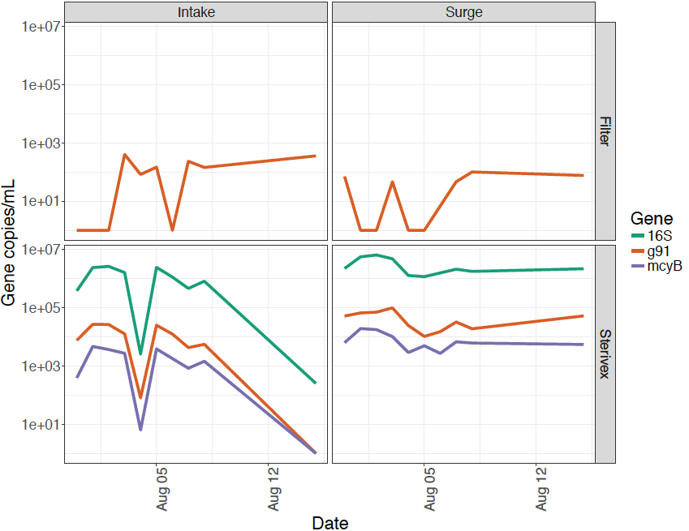
Viral counts, Toledo WTP Aug ‘19
High dissolved toxin suggests viral lysis
Viral counts are low
Lysis not due to this virus, could be another virus
Bloom cells
Viral counts

Slide 9
Sandusky Bay update

Slide 10
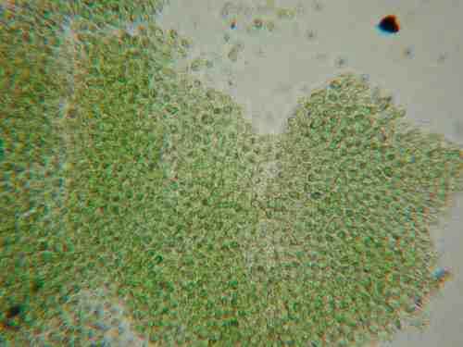
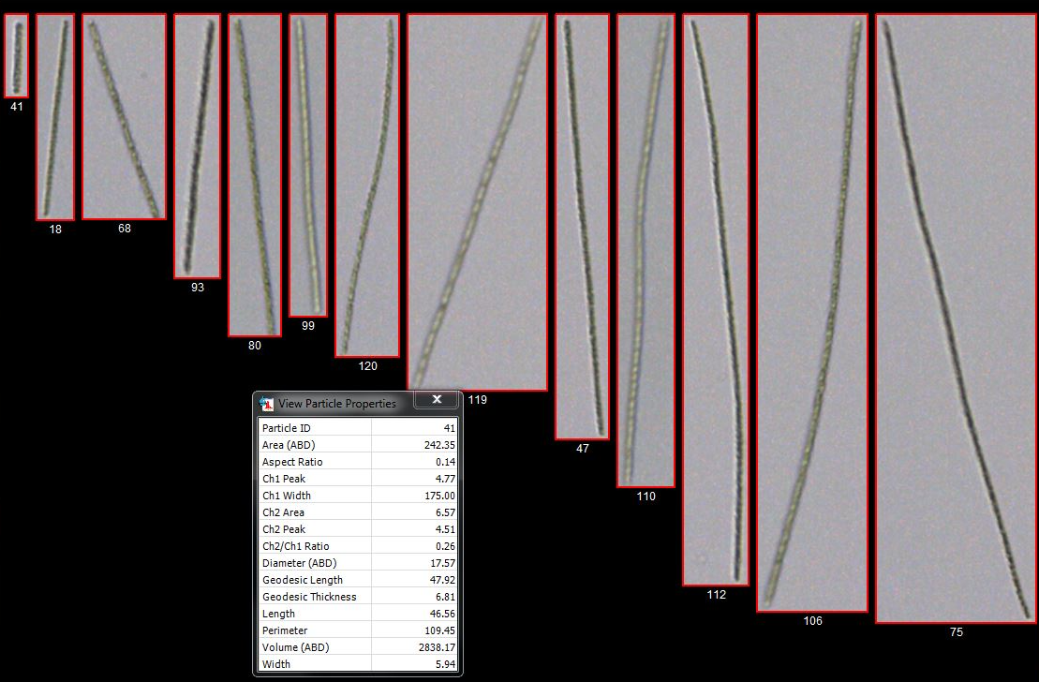
Lake Erie – partitioning of two blooms
Microcystis
Planktothrix

Slide 11
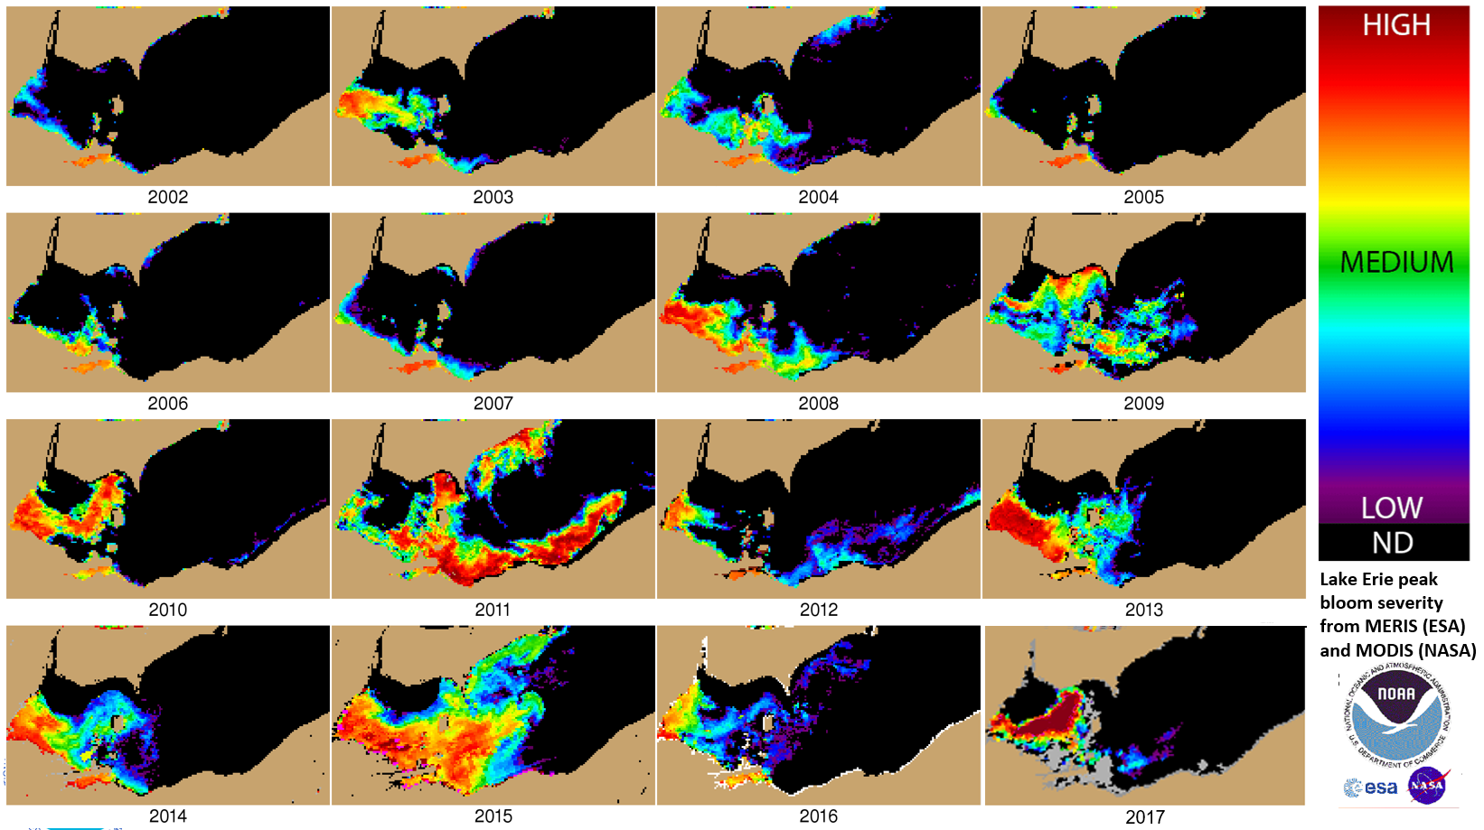
Lake Erie maximum bloom images – Sandusky bloom present every year

Slide 12
Questions
Is Internal loading a source of P to the bloom?
Answer: yes
What drives sediment resuspension?
Wind vs. river discharge?
Answer: both are important
How does Planktothrix respond to light intensity?
Do they experience photoinhibitory irradiances?
Answer: yes, at the surface
Can sediment management help mitigate the bloom?
Is sediment resuspension a major source of nutrients to the bloom?
We don’t know yet
Are there pathogens present that can constrain the bloom?
Yes, chytrid fungi and phages

Slide 13
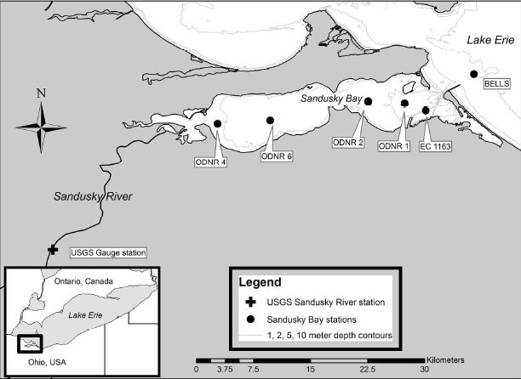
Monitoring sites

Slide 14
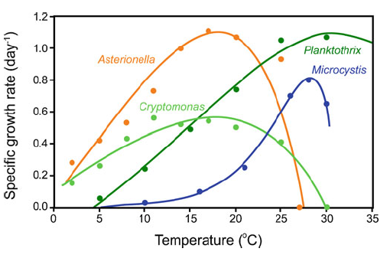
Why is Planktothrix successful in SB?
Low light adaptation?
Scheffer et al. 1997
Temperature?
Post and Mur 1984
Nitrogen availability?
Planktothrix scavenges N better than Microcystis (Hampel et al. 2018)
Planktothrix can tolerate long-term N depletion

Slide 15
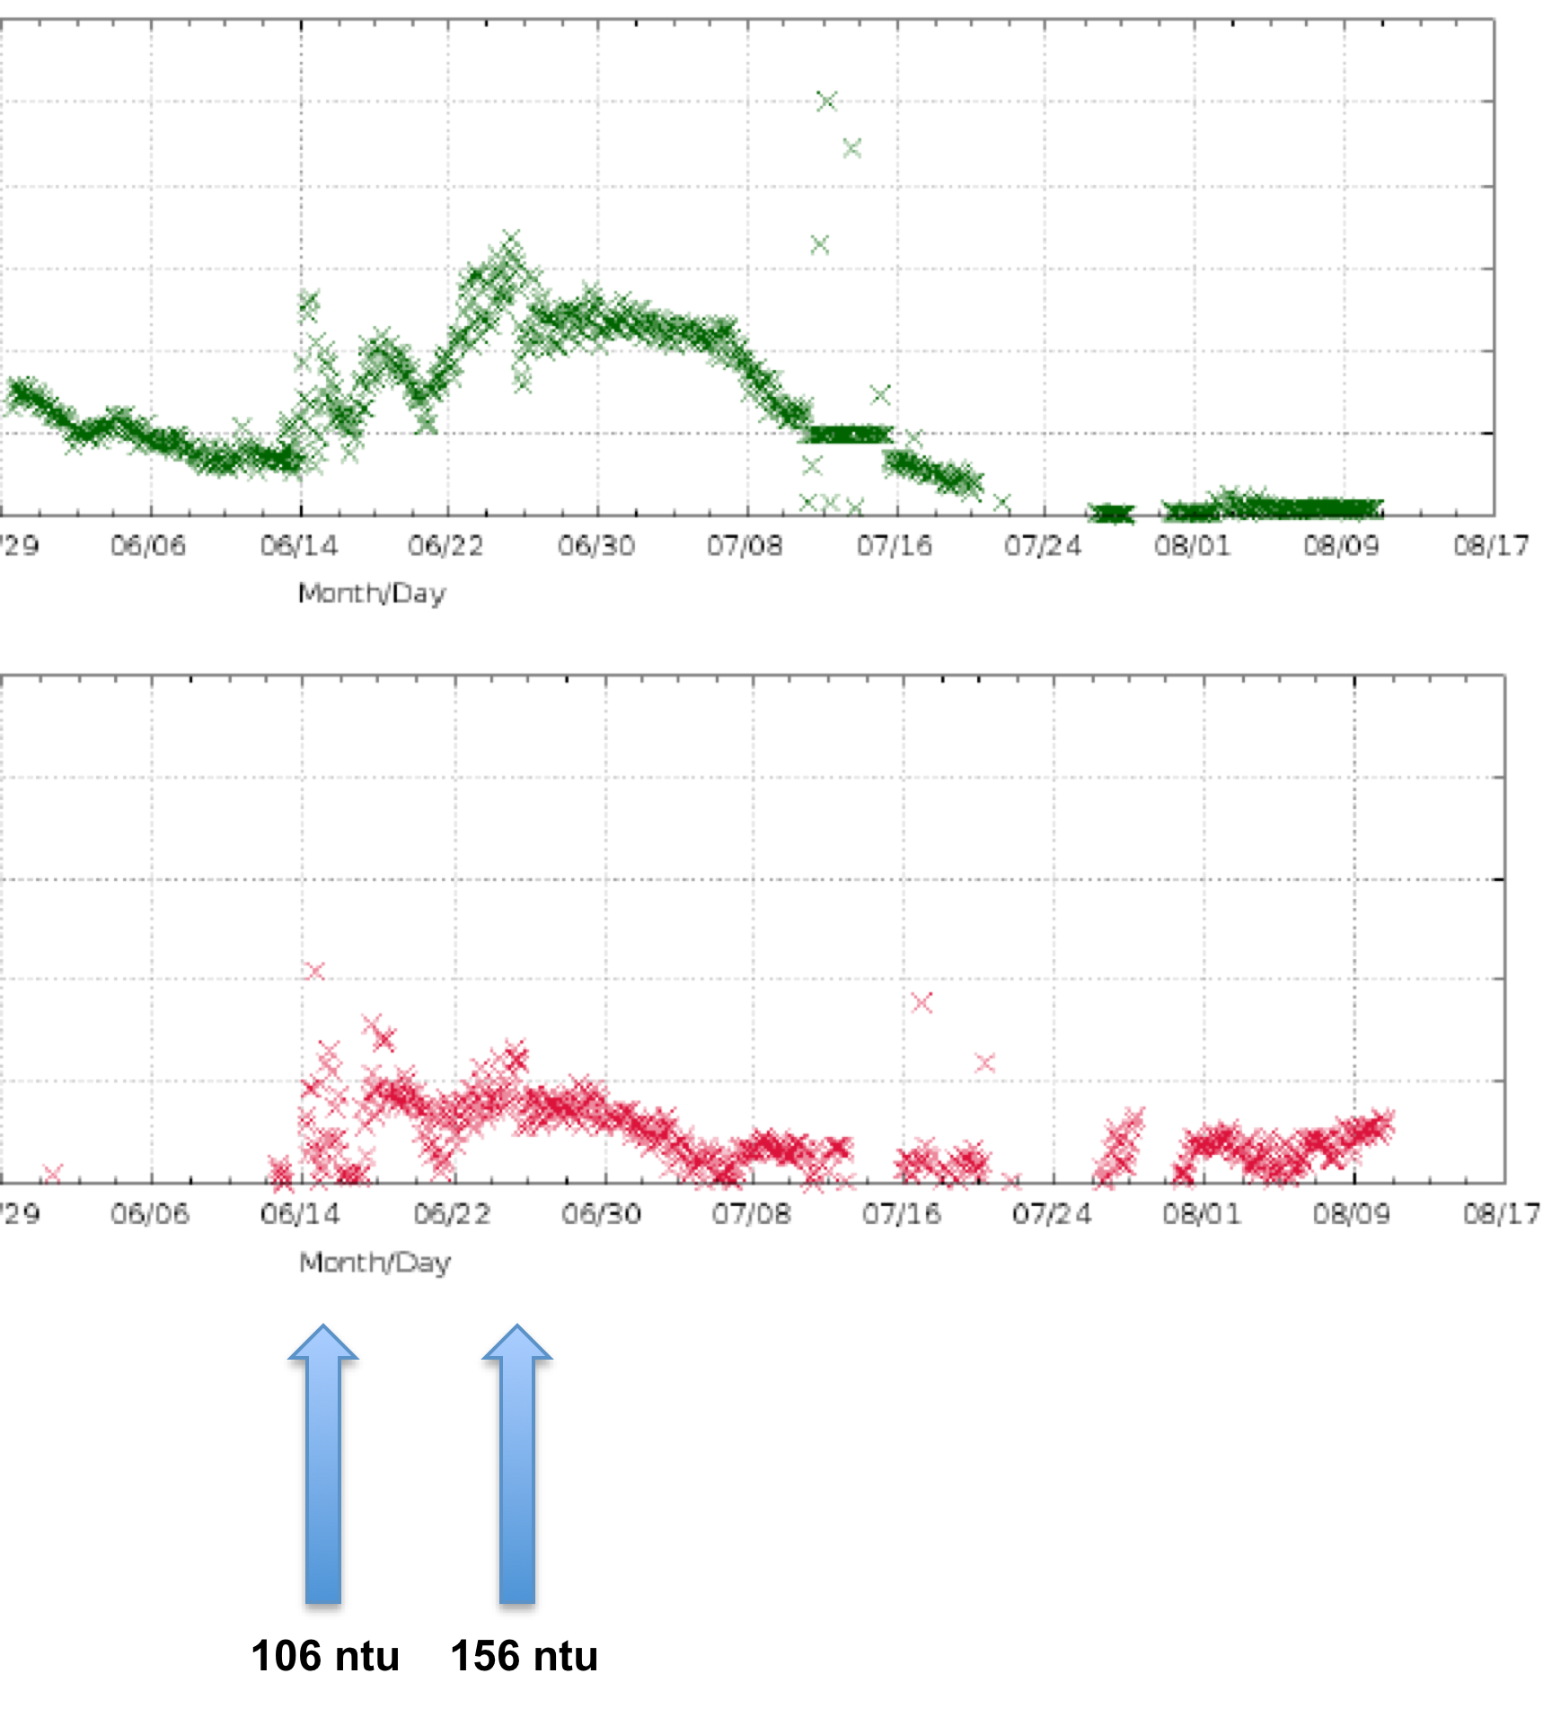
Real time nutrient data, 2019 (Edison Bridge)
Nitrate (mg L⁻¹) 6.0
0
Phosphate (mg L-1) 0.6
0.0
Internal loading
Highest turbidity and river discharge

Slide 16
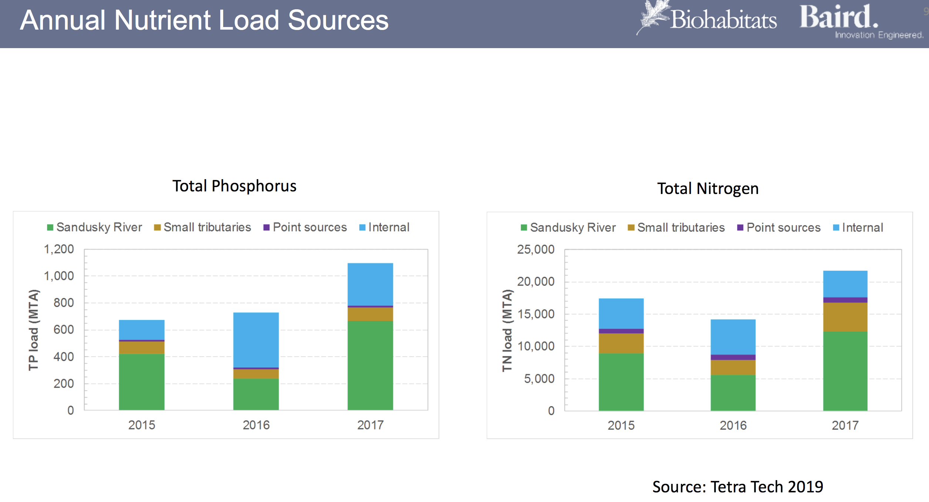
Nutrient load sources (Tetra Tech/Biohabitats)

Slide 17
Denitrification contributes to N losses
Rates are ca. 10 fold higher than areal rates in western Lake Erie (Small et al. 2016)
Planktothrix is well adapted to a low N environment
See Davis et al. (2015) ES&T and Salk et al. (2018) Biogeosciences

Slide 18
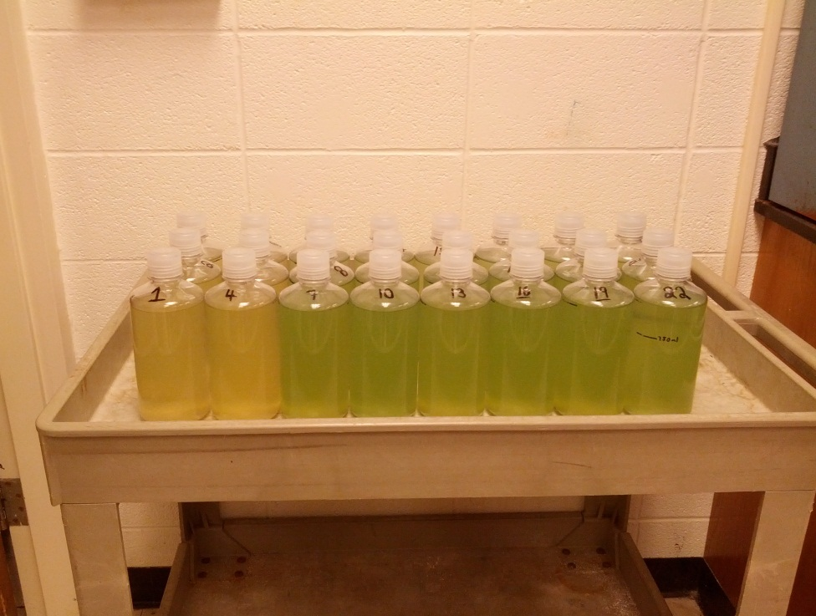
Planktothrix is stimulated by N inputs, not P
Davis et al. 2015 Environ. Sci. Technol.
P+ P+ P+
C P NO₃ NH₄ Urea NO₃ NH₄ Urea

Slide 19
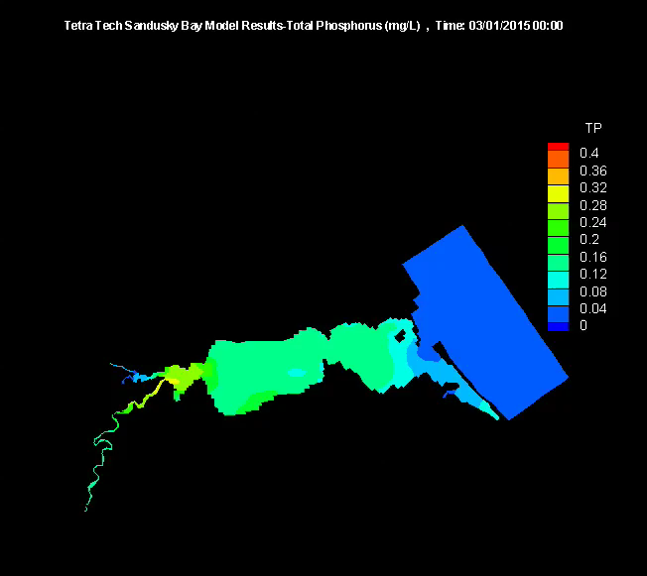
Integration of all data yields models for water flow and nutrient loading in Sandusky Bay
Credit: Kevin Kratt, Tetra Tech
Credit: Kevin Kratt, Tetra Tech
How might these data be useful?

Slide 20
Physical measurements 2017 (flow, turbidity, discharge)

Slide 21
NTU
9/12 9/22 10/2 10/12 10/22 11/1

Slide 22
October wind speeds, Lorain
Turbidity and flow velocities are coincident with wind on 10/8, 10/24 and 10/31
Not coincident at 10/14

Slide 23
So wind leads to high velocities and sediment resuspension
Does sediment resuspension deliver nutrients to the Planktothrix bloom?
We have the tools in place, but we don’t know yet

Slide 24
Bloom characteristics
Planktothrix mostly, but some N-fixing cyanobacteria during N depletion
Evidence that bloom biomass is low-light adapted and under light stress

Slide 25
Responses of Planktothrix to irradiance
mg C mg chl⁻¹ h⁻¹
μmol quanta m⁻² s⁻¹

Slide 26
Summary of completed work
Planktothrix bloom is adapted to low N (Salk et al. 2018)
Bloom biomass is low light adapted
Biomass shows symptoms of high light stress
hliA gene expression, growth assays
Improve water clarity – reduce the bloom?
Discharge linked to peak in dissolved nutrients
Turbidity is not uniformly linked to river discharge
Wind events are important in driving turbidity

Slide 27
Current work
Cell counts/biovolume to inform remote sensing analyses (Rick Stumpf, NOAA)
Useful for EPA impairment designation
Deployment of NuLab nutrient analyzer at the Bridge site
Sediment geochemistry (Lauren Kinsman-Costello)
Assessment of Planktothrix pathogens

Slide 28
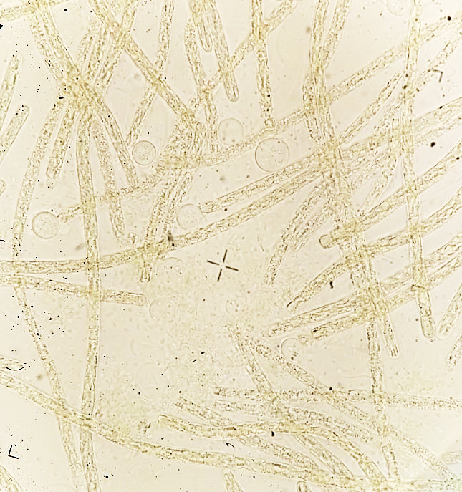
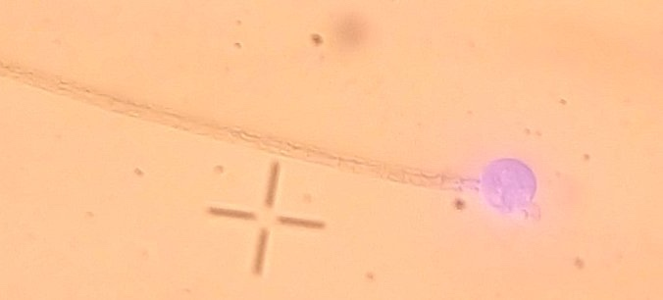
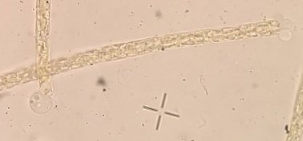
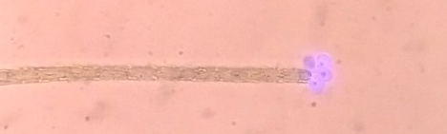
Culturing chytrids on Planktothrix agardhii
Sporangia seen only on filament termini

Slide 29
Future
Management of sediments to improve water clarity and discharge of nutrients
Biohabitats/Baird: Sandusky Bay Initiative
Goal: to photoinhibit the bloom, establish SAV
Extensive deployment of sensors to yield a ‘smart lake’
Goal: to assess effectiveness of restoration efforts
Determine nutrient loads through sediment resuspension (if any)
Assess Planktothrix losses through pathogenesis and grazing
Identify conditions favoring Planktothrix bloom decline

